Slide 1


"Diversifying Revenue Streams in MSK Practice: Balancing Business with Better Care"
Dominic Smith
Head of Business Development - Physiquipe

Slide 2
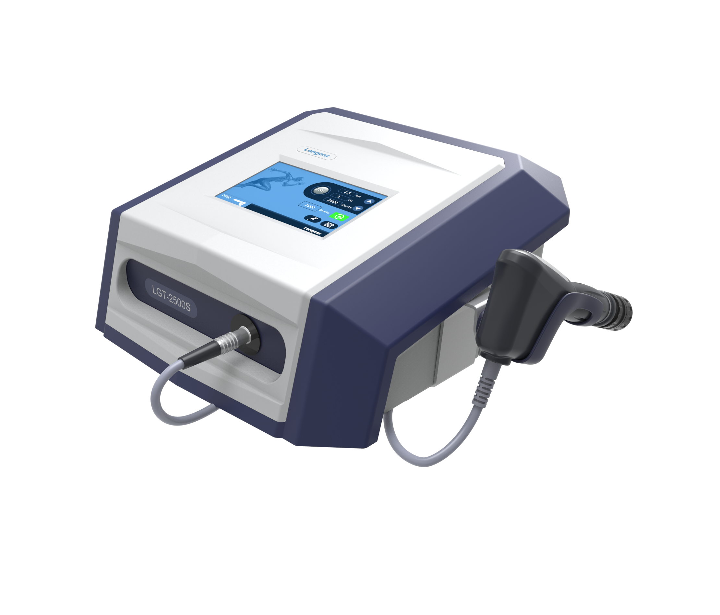
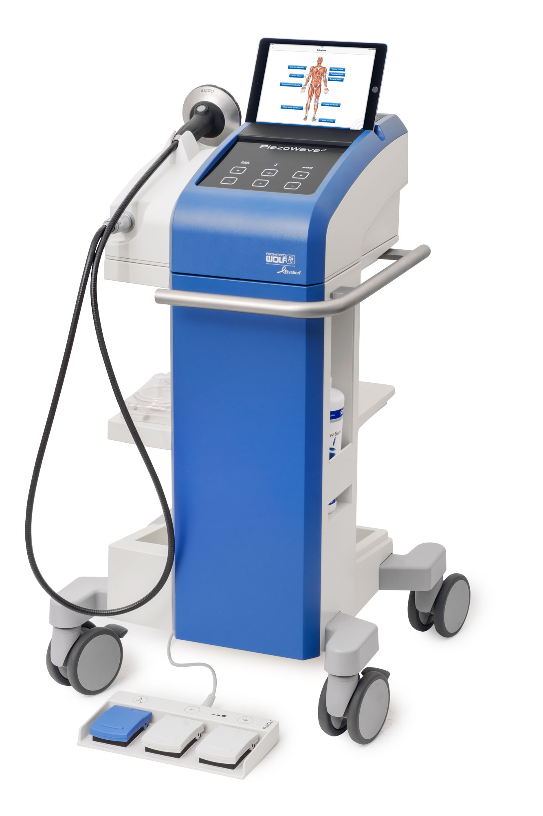
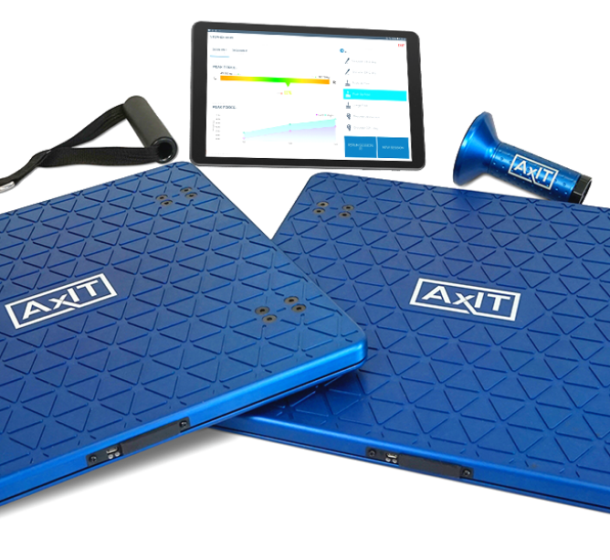
Introduction & Disclosures
Physiquipe represents:
  Piezowave2
    (focused shockwave)
  Longest Powershocker
    (radial shockwave)
  Strength By Numbers
    (force plates & dynamometry)

Slide 3
Why Diversify?
Diversification isn’t just about revenue:
Improves patient care:
Evidence-based care:
Business resilience:
Choice = value for both patients and the clinic.
Offers more treatment choices.
Different tools for different needs.
Protects against changes in demand, staffing, or income streams.

Slide 4

Understanding ROI
What is ROI to you?”
  Financial return
  Improved clinical outcomes
  Greater efficiency/Cost savings
Know what you're measuring.
Initial investment is important — but so is the lifetime cost.
⚠️“Cheaper upfront” doesn’t always mean “cheaper long-term”⚠️

Slide 5
Real-World Example #1
Small Clinic – 3 staff 2 rooms.
Purchased Radial shockwave, Lease Model £150/month lease
Sees 100 patient appts/month on average
Increased all service fees by £3
Covering the new overhead of £150 a month
Plus an extra ~£150-£200/month profit
📌 No extra charge for shockwave. It was embedded in the service — simple, value add and no friction.

Slide 6
Real-World Example #2
Medium Clinic – 10 staff 6 rooms.
Purchased Focused shockwave outright - ~£30,000
Sees approx. 800 patient appts/month
60 min follow up = £80 & 30 min follow up = £50
Shockwave Purchase Options Offered:
1) PAYG = £35 for 15 mins
Total revenue in 9 months
PAYG – ~200 sessions = ~£7,000
Supplement (+£30) – ~150 = ~£4,500
3x treatment package (+£23) – ~400 = £9,200
Total revenue from approx. 800 appts (av. 22 a week)
£20,700 (~£2,300 /month)
£9,300 until “breakeven”
2) Supplement on 30 min follow-ups (+£30)
3) 3x 30 min treatment package (£220 = £23 supplement)
📌 Patients had a choice of pricing model — and found value in the services offered.

Slide 7

Shockwave – Revenue and Reputation
Yes, shockwave generates revenue — but:
  It works when applied correctly.
  Has become a victim of its own hype — especially due to over-commercialization from industry
  Sudden rise and fall and re-rise from past reimbursement rates.
Be selective:
  Use evidence-based protocols
  Offer value, not just a price tag
  Avoid overselling it — that kills trust.

Slide 8
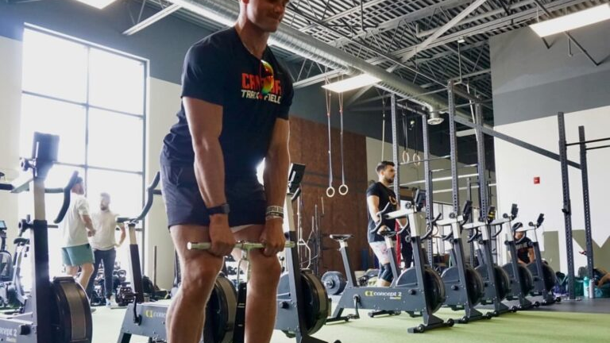
Force Plates & Dynamometry
Often misunderstood in revenue potential.
Avoid a focus on standalone revenue — instead:
  Use them to enhance assessment quality.
  Support better rehab decisions.
  Increase patient buy-in with visuals and progress tracking.
Example: ACL Case
  10 tests in 15 mins.
  Revealed strong balance, poor isolated knee flex/extension.
  Rehab adjusted based on real need, not assumption.
📌 Targeted rehab = better care = improved outcomes.
Outcome quality = long-term patient loyalty.

Slide 9
The Risk of Over-Diversification:
A Cautionary Tale from Shockwave
Shockwave therapy has been pushed hard by industry as a solution for almost everything.
  Often driven by manufacturers with limited product portfolios.
  Strong marketing narratives and bold claims are common — but not always backed by solid evidence.
🎯 What’s the Impact?
Dilutes clinical value — loses sight of where shockwave is truly effective.
Damages trust — clinicians become sceptical, patients become confused.
Devalues the technology — it becomes seen as hype, not healthcare.
🔍 Lessons for Clinics
Be aware of who is pushing what — and their vested interests.
Don’t follow the trap of offering everything to everyone.
Stick to core values — diversify within a strategy, not beyond it.

Slide 10

Final Thoughts
Diversify with intent - Ask:
  “Does this add value to my patients?”
  “How will this improve our services?”
  “Will this help my team perform better?”
Pricing and positioning matter.
  Avoid making patients feel like it’s an ultimatum e.g. this or nothing –
    If possible, give a choice within the treatment (PAYG, Supplement, Packages).
Stick to your clinical identity and core values — diversify within strategy, not beyond it.
Focus on where the tool adds real value — explore new areas cautiously and responsibly.
💬 “Just because your can/could do everything doesn’t mean you should.”

Slide 11
“Diversification isn’t about selling more stuff”
—
“It’s about being a better clinic with more tools, more clarity, and more value for your patients.
When done right, the revenue looks after itself.”

